Slide 1
CMSC 471
ML: Brief Intro to Neural Network

Slide 2
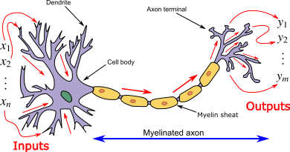
How do animal brains work?
Neuron and myelinated axon, with signal flow from inputs at dendrites to outputs at axon terminals
Neurons have body, axon and many dendrites
In one of two states: firing and rest
They fire if total incoming stimulus > threshold
Synapse: thin gap between axon of one neuron and dendrite of another
Signal exchange

Slide 3
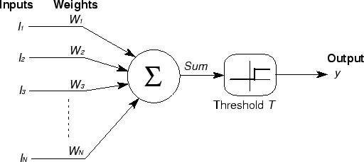
McCulloch & Pitts
First mathematical model of biological neurons, 1943
All Boolean operations can be implemented by these neuron-like nodes
Competitor to Von Neumann model for general purpose computing device
Origin of automata theory

Slide 4
Artificial neural network
Model still used today!
Set of nodes with inputs and outputs
Node performs computation via an activation function
Weighted connections between nodes
Connectivity gives network architecture
NN computations depend on connections, weights, and activation function
Notes:
Set of nodes
Node have inputs and outputs
Nodes performs computation via its activation function
Weighted connections between nodes
Connectivity gives structure/architecture of net
What can be computed by a NN determined by the connections and their weights
Simplified version of networks of neurons in animal nerve systems

Slide 5
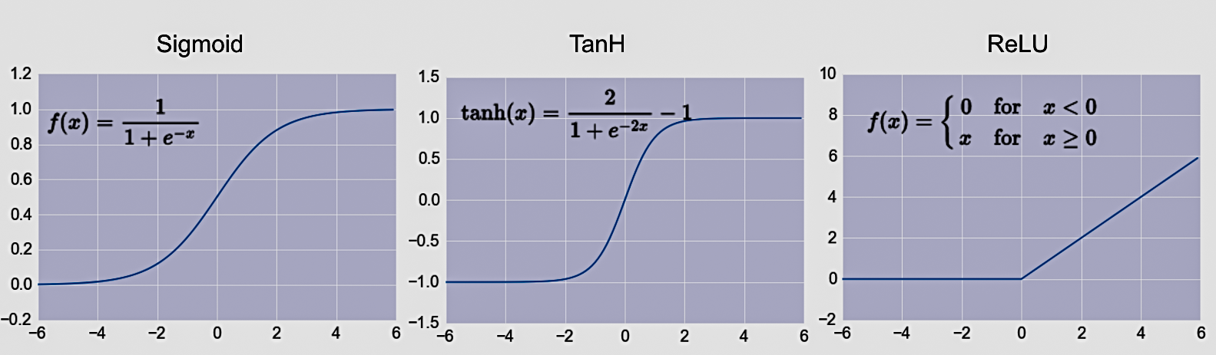
Common Activation Functions
defines the output of that node given an input
Choice of activation function depends on problem and available computational power

Slide 6
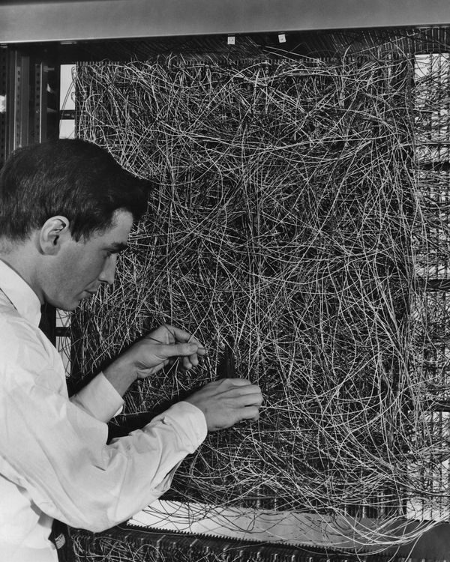
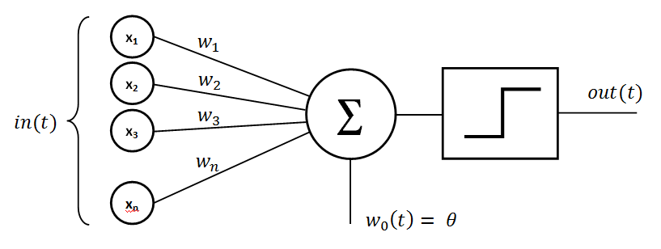
Rosenblatt’s perceptron (1958-60)
Single layer network of nodes
Real valued weights +/-
Supervised learning using a simple learning rule
Essentially a linear classifier
Widrow & Hoff (1960-62) added better learning rule using gradient descent
Mark 1 perceptron computer, Cornell Aeronautical Lab, 1960

Slide 7
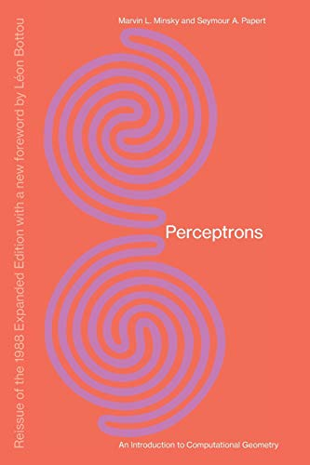
Problem with SLPs
Perceptrons, Minsky and Papert, 1969
Described serious problems with perceptron model
Single-layer perceptrons cannot represent (learn) simple functions that are not linearly separable, such as XOR
Multi-layers of non-linear units may have greater power but there is no learning rule for such nets
Scaling problem: connection weights may grow infinitely
First two problems overcame by latter effort in 80s, but scaling problem persists

Slide 8
Not with a perceptron ☹
Consider Boolean operators (and, or, xor) with four possible inputs: 00 01 10 11
Training examples are not linearly separable for one case: sum=1 iff x1 xor x2

Slide 9
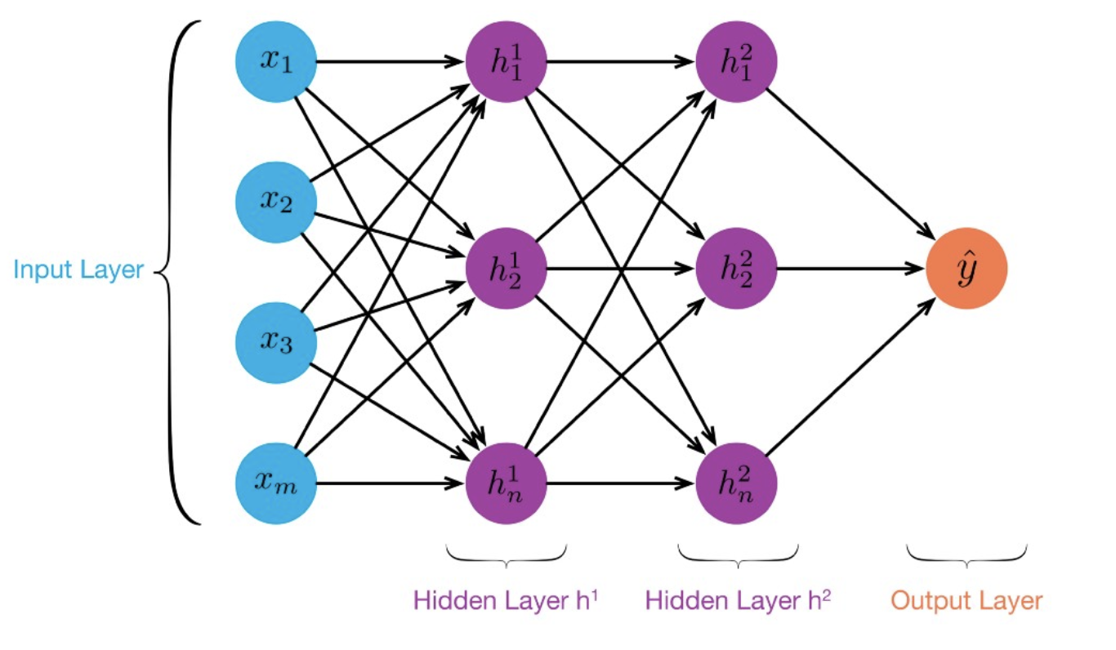
MLP: Multilayer Perceptron
≥ 1 “hidden layers” between inputs & output
Can compute non-linear functions
Training: adjust weights slightly to reduce error between output y and target value t; repeat
Introduced in 1980s, still used today

Slide 10
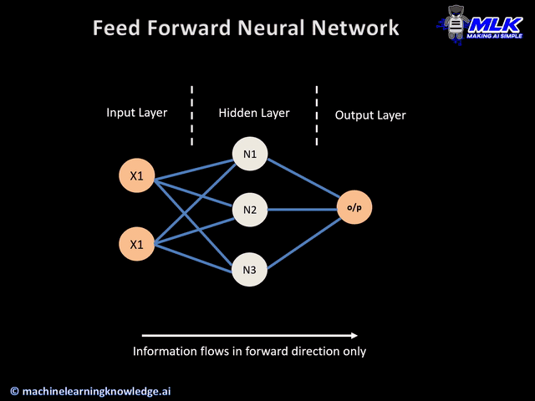

Slide 11


Slide 12
But problems remain…
It’s often the case that solving a problem just reveals a new one that needs solving
For a large MLPs, backpropagation takes forever to converge!
Two issues:
Not enough compute power to train the model
Not enough labeled data to train the neural net
SVMs dominate, since they converge to global optimum in O(n^2)

Slide 13
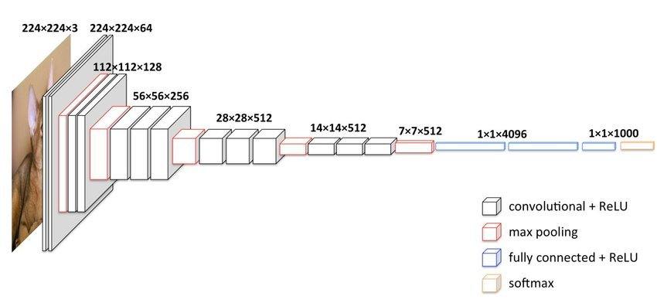
Deep Learning
Deep learning refers to models going beyond simple feed-forward multi-level perceptron
Though it was used in a ML context as early as 1986
“deep” refers to the models having many layers (e.g., 10-20) that do different things
The VGG16 CNN model for image processing

Slide 14
Neural Network Architectures
Current focus on large networks with different “architectures” suited for different kinds of tasks
Feedforward Neural Network
CNN: Convolutional Neural Network
RNN: Recurrent Neural Network
LSTM: Long Short Term Memory
GAN: Generative Adversarial Network
Transformers

Slide 15
CNN: Convolutional Neural Network
Good for image processing: classification, object recognition, automobile lane tracking, etc.
Classic demo: learn to recognize hand-written digits from MNIST data with 70K examples

Slide 16
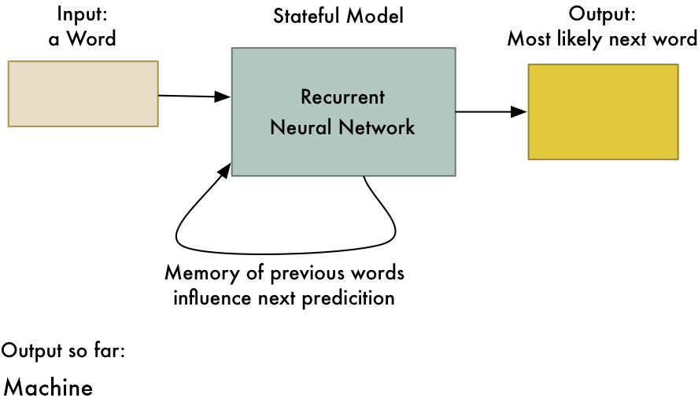
RNN: Recurrent Neural Networks
Good for learning over sequences of data, e.g., a sentence orf words
LSTM (Long Short Term Memory) a popular architecture
gif from Adam Geitgey

Slide 17

Keras
“Deep learning for humans”
Keras npw (v2.4) only supports TensorFLow
Supports CNNs and RNNs and common utility layerslike dropout, batch normalization and pooling
Coding neural networks used to be a LOT harder: Keras makes it easy and accessible!
Documentation: https://keras.io/

Slide 18
Conclusions
Quick intro to neural networks & deep learning
Learn more by
Take UMBC’s CMSC 478 machine learning class
Try scikit-learn’s neural network models
Explore Keras as : https://keras.io/
Explore Google’s Machine Learning Crash Course
Try Miner/Kasch tutorial on applied deep learning
Work through examples
and then try your own project idea

